Slide 1
RCPLI
August 2016

Slide 2
What is the KST?
Developed by Humboldt County Kindergarten teachers
18 item screening tool
Evidence informed
Notes:
The Kindergarten Screening Tool or KST is an 18 item screening tool developed by a team of 10 kindergarten teachers in Humboldt County with the support of the Humboldt County Office of Education. It was designed to provide a snap shot of a child’s skills as they enter Transitional Kindergarten or Kindergarten.
This tool is evidence informed, based on readiness skills outlined in the Preschool Learning Foundations, Kindergarten Common Core Standards and comparison of more than 30 kindergarten teacher’s entry level assessments.

Slide 3
Why was it developed?
Notes:
The KST was developed to provide information for first parent conferences/report cards, to provide countywide base line data on school readiness that reflects common core standards and in some districts to assist with determining placement in TK or K.
Teachers insisted on an online data entry component that could be done easily with an ipad and would be quick and easy to use.
The tool was also developed to inform the community about school readiness focused interventions based on the needs identified from analysis of the countywide data.

Slide 4
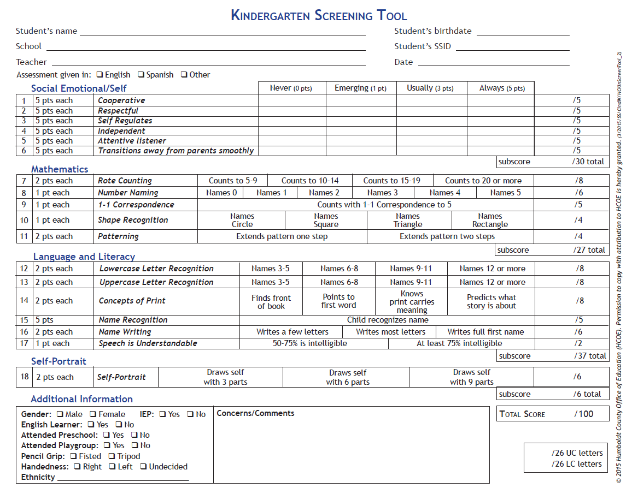
What skills does it assess?
Notes:
Four areas of development are screened. Kindergarten teachers felt strongly that social emotional development is equally weighted with the academic areas, language and literacy, mathematics and self portrait. Teachers felt the self portrait offered them the opportunity to see how the child views themselves while quickly assessing their fine motor development. Additional information is also reported on each child such as gender and previous attendance at preschool or playgroup. This information can be gathered through a parent survey or by asking each of your parents. Attending preschool or playgroup covers a wide range of possibilities, for example a parent may consider an informal weekly gathering with other parents and their children a playgroup. That is why these items are dependent on parent reporting.

Slide 5
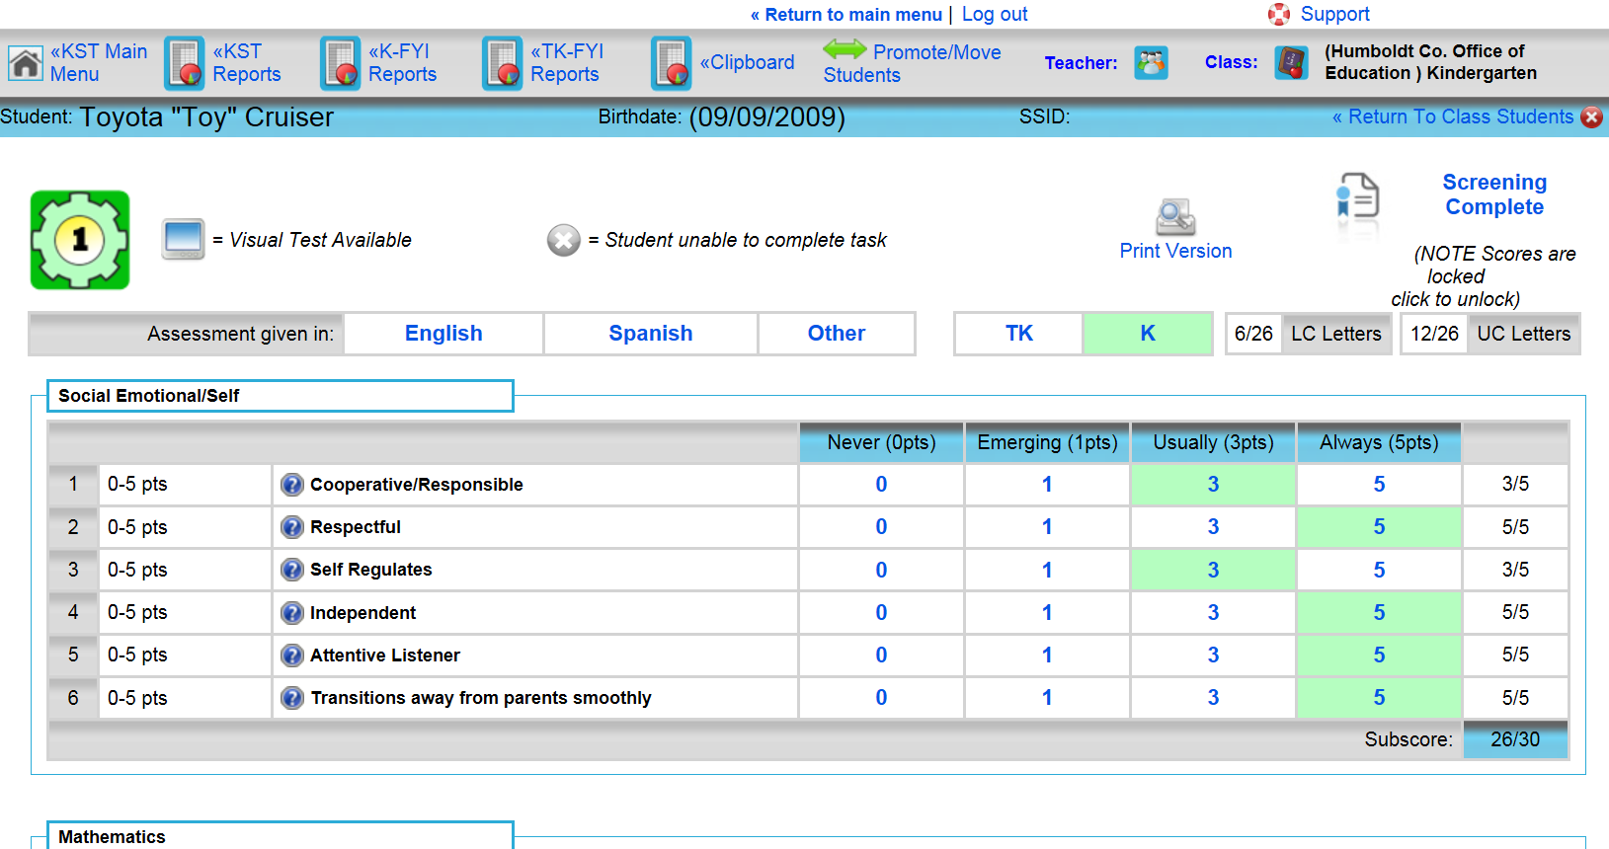
The Digital Dream!!

Slide 6
How can I use the data?
Notes:
This past year 78 TK/K teachers in Humboldt County used the KST to gather data on 89% of all incoming kindergarteners in the county. Teachers found they could use the data they gathered as a base line measure of where the child’s skills were upon entry to kindergarten, to establish classes (if used before school starts), to establish groups within the first few weeks of school an to refer children for support services (speech, EL, tutoring, etc). Most of your students have been attending TK or K for more than 6 months so this will not be an accurate measure of their readiness. Although you mind find this information useful when looking at the readiness of your TK students for kindergarten or validation for amount your kindergarteners have learned while in your kindergarten class.

Slide 7
KST Data highlights
Notes:
TK to K students
K retention 16 students with similar increases especially with those who didn’t go to preschool. The research shows that if you are going to retain a student, Kindergarten is the place to do it.

Slide 8
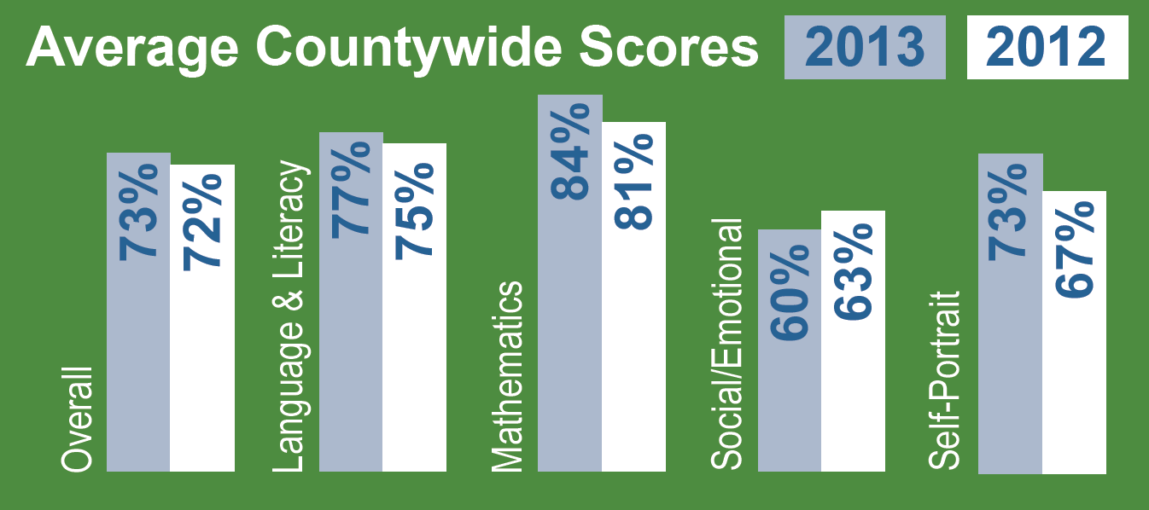
KST Data highlights

Slide 9
Teachers Love It!
“So MAGICAL! It gives you a heads-up as to where your students are beginning.”
- Robin Gray-Stewart, Washington School
“Playing with the data by sub test group has been REALLY ILLUMINATING, and we have all kinds of ideas how it can be useful to us!”
-Jennifer Nichols, Morris School
“A great standardized initial assessment. EVERY TK AND K TEACHER in our district has the SAME INFORMATION.”
- Maikken Bass, Washington School & KST Lead Teacher

Slide 10
Beyond the KST
Report Cards
FYI
Parent Survey
Flash cards / letter to parent

Slide 11
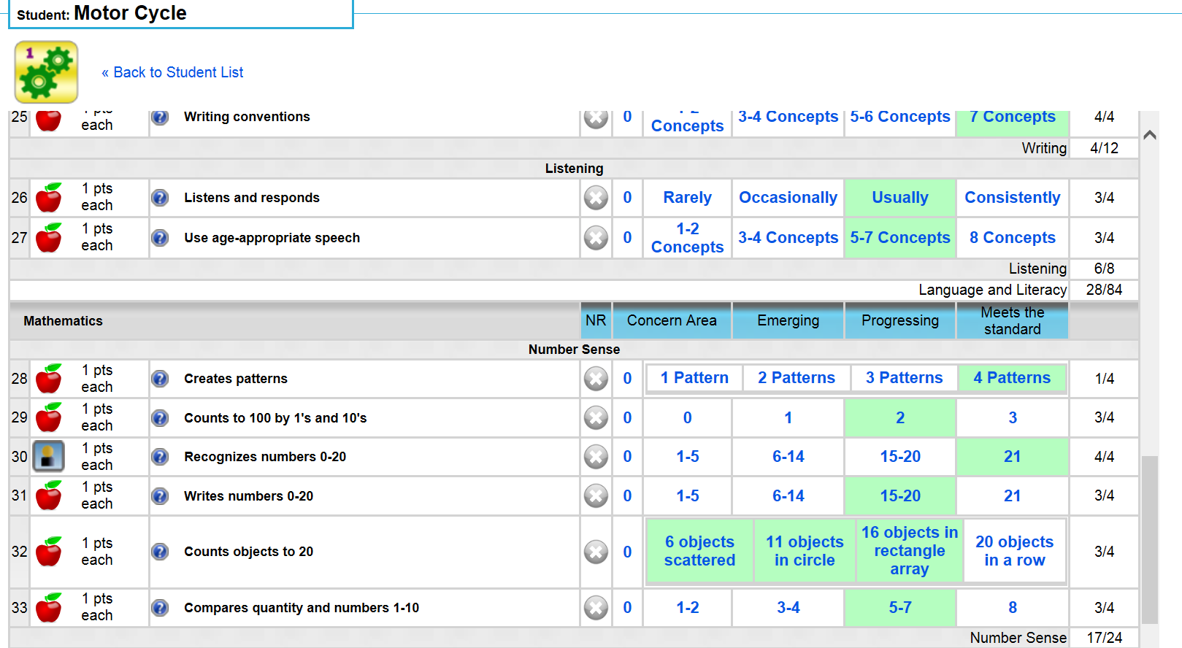
FYI (Full Year Inventory)
Notes:
At these lower grades, these assessments require the teacher to spend more one on one time with the students because of the need for verbal instruction and answers, but they are reporting it has greatly increased their ability to pinpoint the areas students need remediation.

Slide 12
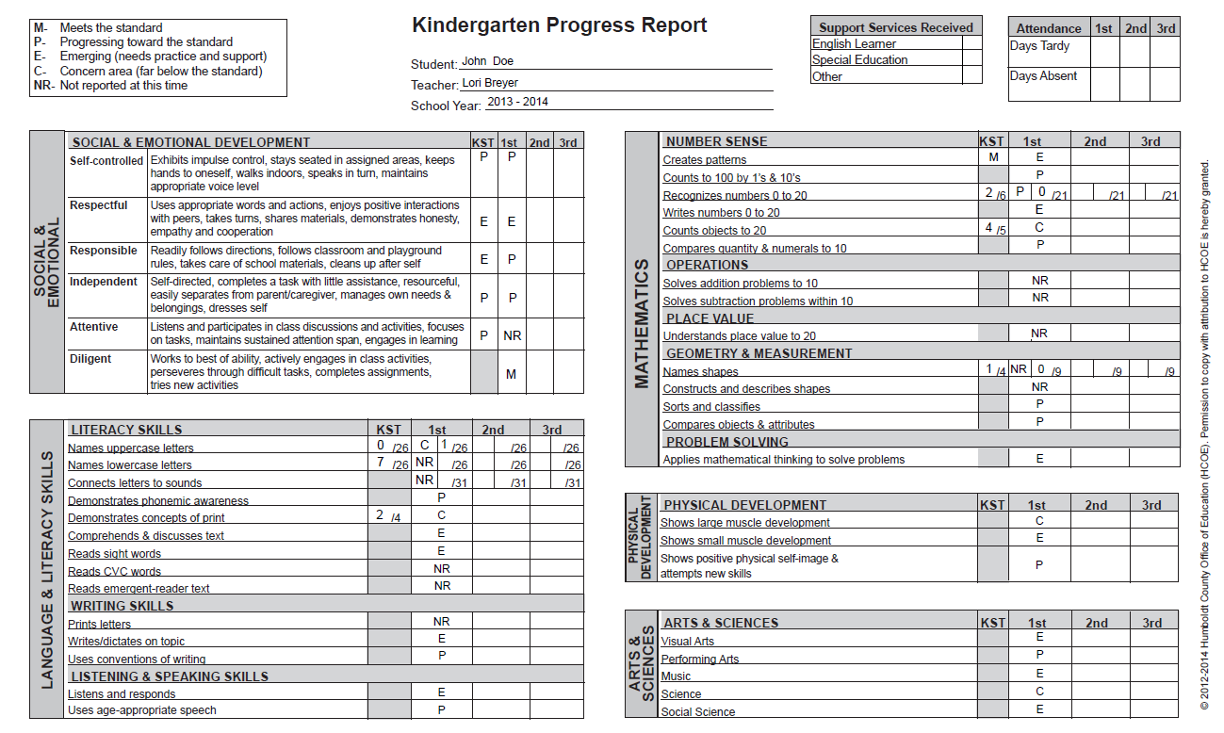
Report Cards
Notes:
Each trimester, the FYI feeds into the common core report card….

Slide 13
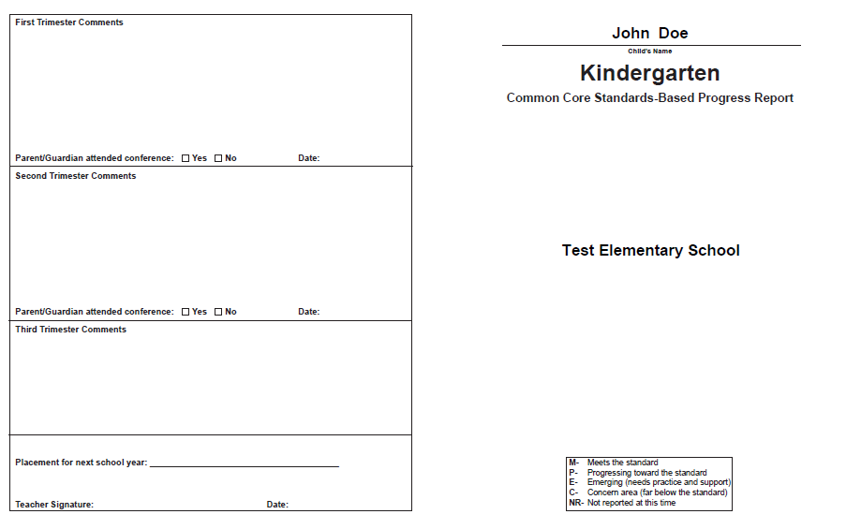
Report Cards
Notes:
And the teacher can type in the comments… we will be adding school logos to these report cards as well.

Slide 14
Efficiency!
“I am extremely grateful and appreciative of this working tool. I have never been able to complete assessments and report cards so efficiently!! Talk about working SMARTER!!! ”
-Jani Ayers, Alice Birney Elementary

Slide 15
Demo time!
www.coregrowth.org

Slide 16
Questions?
Lori Breyer lbreyer@humboldt.k12.ca.us
707-445-7019
Cindi Kaup ckaup@humboldt.k12.ca.us
707-441-3912

